Slide 1

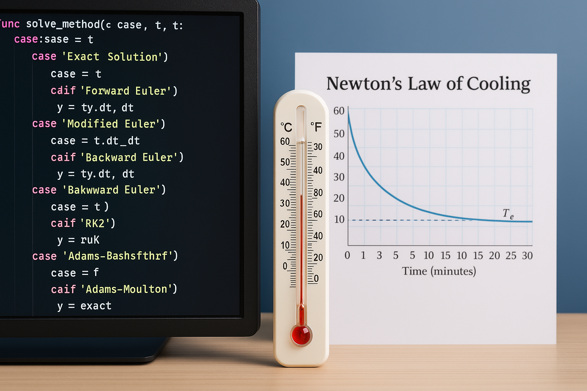
Analysis and Application of Newton’s law of cooling using numerical methods
Cairo University
Faculty of science
Mathematics Department
MATH 352
Numerical Analysis Project

Slide 2
Agenda
Introduction
Explain Newotn’s Law of cooling
Practical Applications of Newton's Law of Cooling
Problems Newotn’s law solve it
How we used all this in our code
Presentation Title

Slide 3
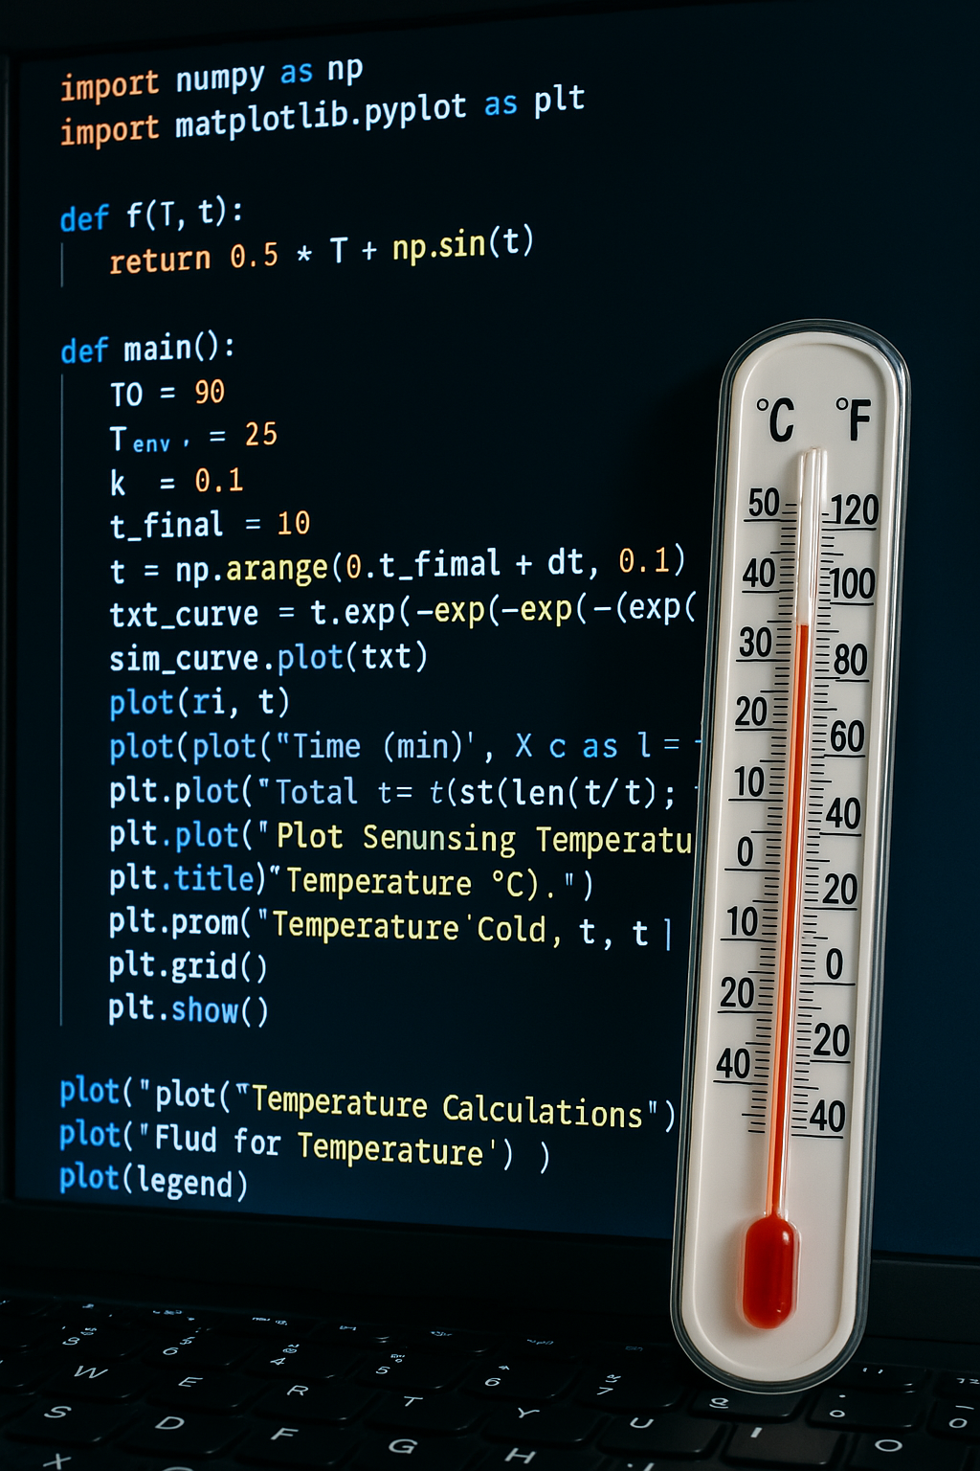
Introduction
This project aims to study Newton's Law of Cooling and its application in real-life scenarios using numerical methods. Newton's Law of Cooling is an important physical law that explains how the temperature of an object changes over time when exposed to a cooler or hotter environment. This law is based on the principle that the rate of temperature change is directly proportional to the difference between the temperature of the object and the surrounding environment.
However, to solve the equation describing this law in some real-world cases, numerical methods are often required.This project focuses on using techniques such as Euler's method to solve the differential equation derived from Newton's Law of Cooling, enabling us to accurately model the temperature changes of objects over time

Slide 4

Explain Newotn’s Law of cooling
Newton’s law of cooling

Slide 5
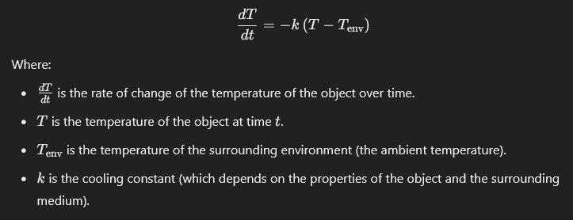
Newton's Law of Cooling
is a physical law that describes how the temperature of an object changes when it is exposed to a cooler or hotter environment. The law states that the rate of change of the object's temperature over time is directly proportional to the difference between the temperature of the object and the surrounding environment.
Mathematical Formula:

Slide 6
Theoretical Explanation Behind Newton's Law of Cooling:
Newton's Law of Cooling suggests that the temperature change of the object occurs faster when the temperature difference between the object and the environment is larger. Therefore, when the object is hotter than the surrounding environment, it cools down more rapidly at first, and as the temperature difference becomes smaller, the cooling slows down.
The cooling constant k is a factor that determines how quickly the object cools down. A larger value of k leads to faster cooling
Physical Explanation:
When the object is hot and the environment is cooler, the temperature difference between the object and the surroundings is large, causing the object to lose heat quickly.
Over time, this rate decreases because the temperature difference becomes smaller until the object's temperature reaches the surrounding environment's temperature, at which point cooling stops
How We Applied This in the Project:
In our project, we applied Newton's Law of Cooling by solving the differential equation derived from this law using numerical methods. Since the equation can be challenging to solve analytically in some cases or may not have an exact solution, we used to approximate the solutions.
Through these methods, we were able to model how the temperature of the object changes over time, based on the value of k, the object's initial temperature, and the environment's temperature. These numerical techniques allowed us to analyze real-world cooling scenarios.

Slide 7

Practical Applications of Newton's Law of Cooling:
Cooling of Food and Beverages:
Newton's Law of Cooling is used to understand how food and beverages cool down after being cooked. For example, it can help determine how long it takes for food to cool down to a safe temperature for consumption.
Electronic Devices:
In technology, the law is used to analyze how electronic devices like computers and smartphones cool down. This helps prevent overheating, which could damage the components.
Forensic Science:
The law is used in death investigations. By analyzing the temperature of the body after death, Newton's Law of Cooling helps estimate the time of death based on the cooling rate of the body.
Mechanical Systems Design:
It's used in the design of thermal systems like cooling systems in cars and airplanes, ensuring that these devices maintain optimal temperature ranges.

Slide 8
Problems Newotn’s law solve it
1-Uncontrolled Cooling:
Problem: In real-life scenarios, cooling processes can be unpredictable and not well-understood, leading to inefficient or improper temperature regulation.
Solution: Newton's Law of Cooling helps us predict how quickly an object will cool down based on the difference in temperature between the object and its surroundings, allowing for better control and efficiency in cooling processes.
2-Inaccurate Heat Loss Estimations:
Problem: In fields like forensic science or material analysis, estimating heat loss from an object or body could be inaccurate, leading to flawed conclusions or inaccurate results.
Solution: The law provides a clear and reliable model to estimate the rate at which heat is lost from an object, improving the accuracy of time-of-death estimations in forensic science and other applications.
3-Inefficient Thermal Management Systems:
Problem: Many systems, such as HVAC (heating, ventilation, and air conditioning) or electronic cooling systems, may not be optimized, resulting in wasted energy or overheating of components.
Solution: By applying Newton's Law of Cooling, engineers can design more efficient systems that regulate temperature more effectively, improving energy usage and preventing damage to electronic devices or structures.

Slide 9
How we used all this in our code
Creating the GUI:
We created a user-friendly graphical interface to allow users to input key parameters:
Initial temperature (T₀)
Environment temperature (T_env)
Cooling constant (k)
Final time (t_final)
The user can select different numerical methods (like Forward Euler, RK4, and Exact Solution) to see how the temperature changes over time.
Defining the Cooling Process:
We used Newton's Law of Cooling, which states that the rate of temperature change is proportional to the difference between the temperature of an object and the ambient temperature.
The equation used in the code is:
The GUI allows users to input values for T₀, T_env, and k to solve the equation for the temperature over time.
Numerical Methods Implementation:
We implemented various numerical methods like:
Euler methods (Forward Euler, Modified Euler, Backward Euler)
Runge-Kutta methods (RK2, RK4)
Adams-Bashforth and Adams-Moulton
Each of these methods approximates the solution to the differential equation, and users can select one from the GUI to see how the temperature changes over time.
Exact Solution:
We also included the Exact Solution to compare the results from the numerical methods with the theoretical solution given by:
This allows the user to see how well the numerical methods approximate the exact solution.
Results and Visualization:
Once a method is selected and parameters are provided, the GUI displays the final temperature and plots the temperature over time.
The results are displayed in a text box showing the final temperature after the selected time, and a plot is generated to visualize how the temperature changes.

Slide 10



Conclusion
In conclusion, this project demonstrates how Newton's Law of Cooling combined with numerical methods provides effective and accurate solutions to real-life problems. From improving thermal system performance to predicting temperature changes in various applications, numerical methods have proven to be a powerful tool for analyzing cooling behavior and solving complex equations.
In the future, this understanding will help us develop more efficient technologies in heat management, whether in electronic industries or environmental systems, leading to increased energy efficiency and reduced costs in various fields.

Slide 11
Our Team
Marwan Ahmed Sayed
2227368
AbdElrahman
Yahia 2227078
Mustafa Mahmoud Abdelaziz
2227263
Hassan
Mohamed
Hassan 2227235

Slide 12

Thank you

